Slide 1
Infinigen
Hang Zhou

Slide 2
Infinite Photorealistic Worlds using Procedural Generation
Alexander Raistrick, Lahav Lipson, Zeyu Ma, Lingjie Mei, Mingzhe Wang, Yiming Zuo, Karhan Kayan, Hongyu Wen, Beining Han, Yihan Wang, Alejandro Newell†, Hei Law†, Ankit Goyal†, Kaiyu Yang†, Jia Deng Department of Computer Science, Princeton University

Slide 3
Motivation
Large-scale labeled data
Hard to acquire (esp. 3D)
Synthetic data
Generalize to real images zero-shot
Limited use of synthetic data
Limited diversity of 3D assets
Notes:
Important for computer vision
Synthetic data from computer graphics, and has shown great promise in 3D vision

Slide 4
Overview
A procedural generator of photorealistic 3D scenes of the natural world
Advantage:
Procedural: create infinitely many distinct shapes, textures, materials, and scene compositions
Diverse
Photorealistic
Real geometry
Free and open-source: built on Blender

Slide 5
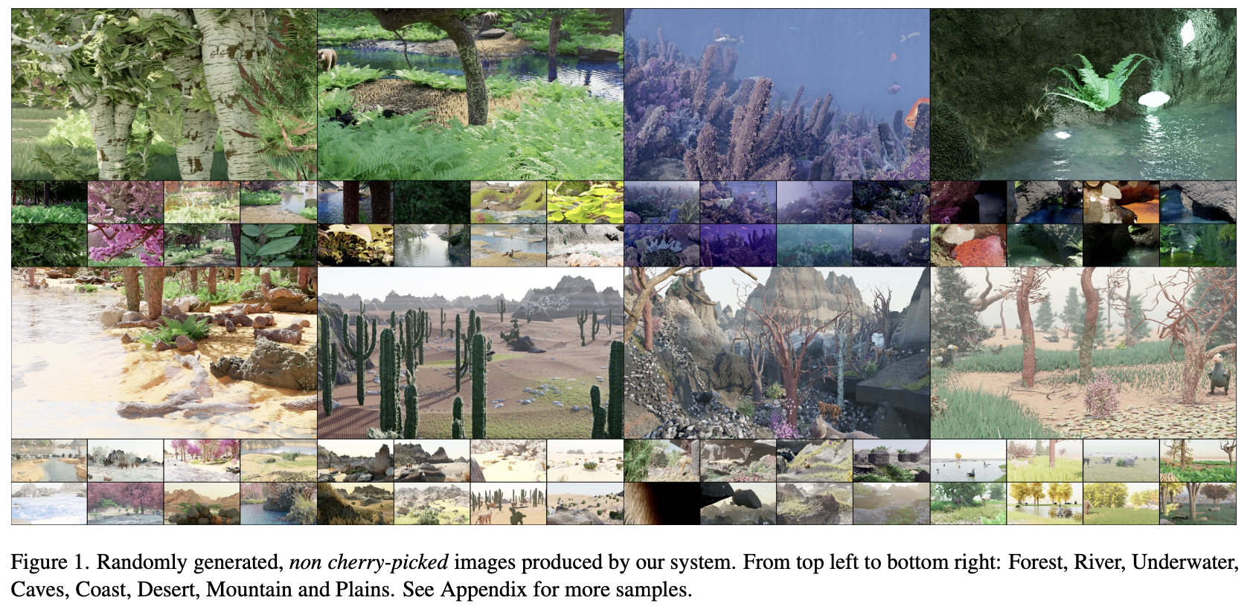

Slide 6
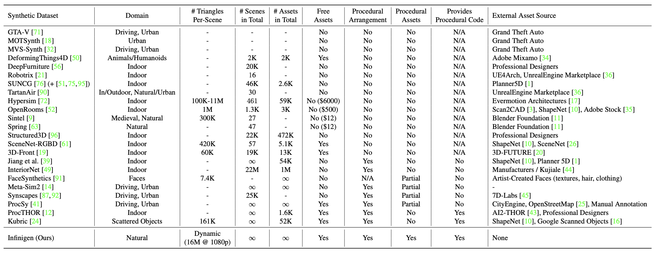
Comparison with other synthetic datasets

Slide 7
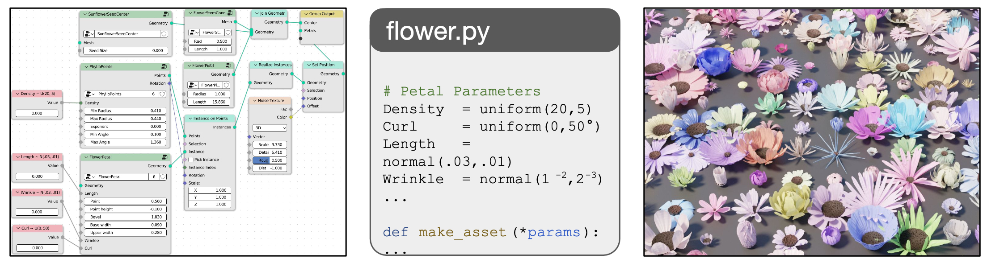
Method
Blender preliminary: node-graph interface:
shader nodes, geometry nodes
Node Transpiler
automates the process of converting node-graphs to Python code; supports all forms of blender nodes
Notes:
Shader Nodes to compose primitives into a photo-realistic material.
Geometry Nodes define a mesh using nodes representing operators such as Poisson disk sampling, mesh boolean, extrusion etc.

Slide 8
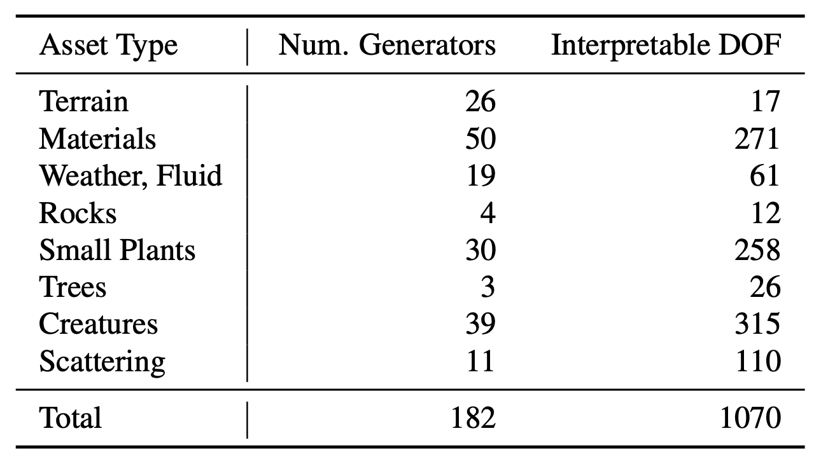
Method
Generator subsystems
probabilistic programs each specialized to produce one subclass of assets
Approximate degrees of freedom

Slide 9
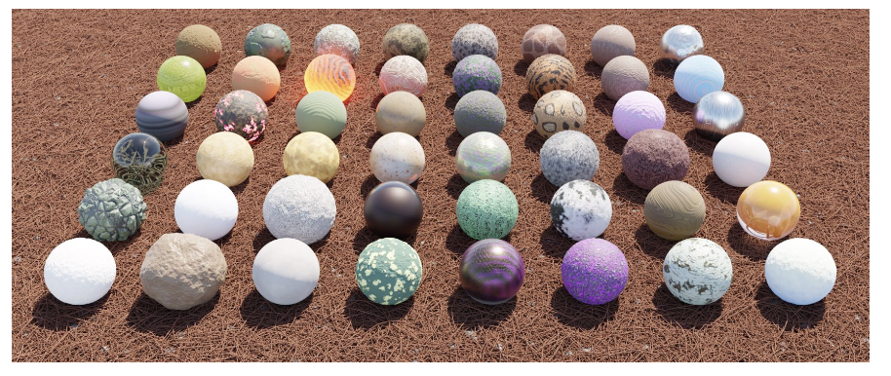
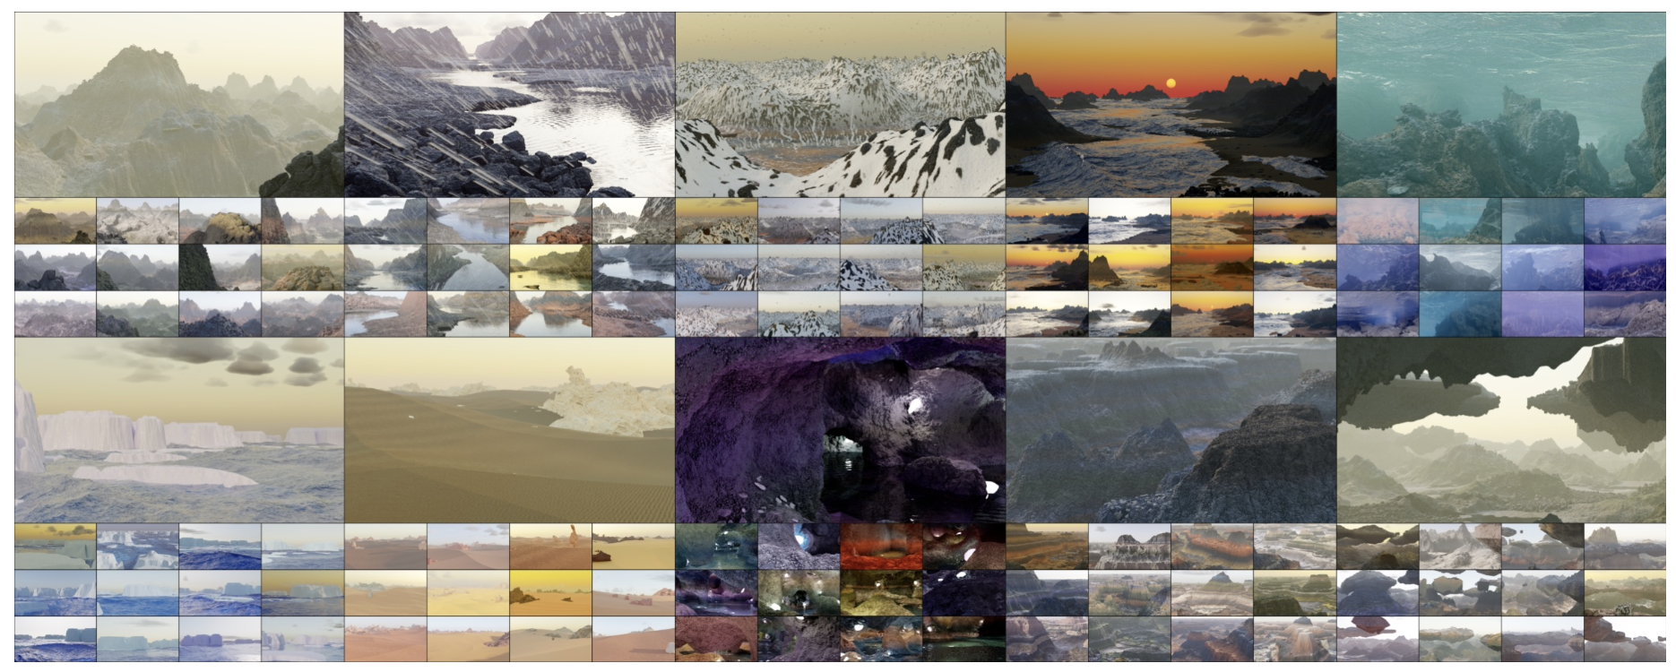
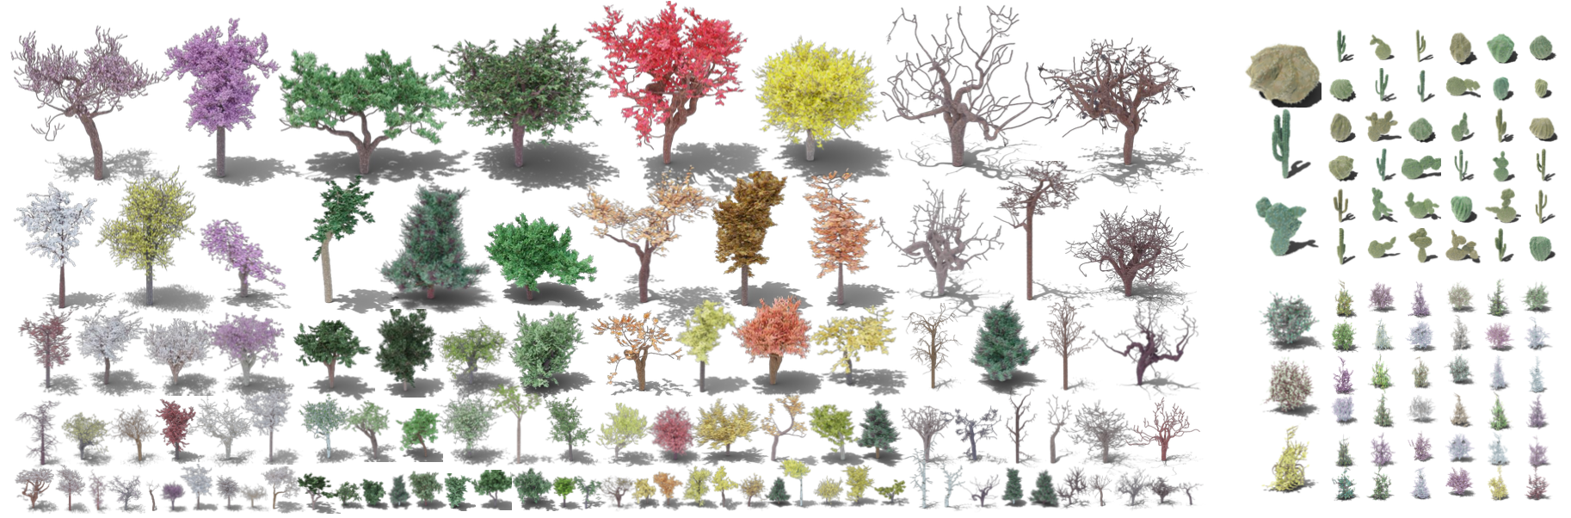
Method
Material generators
Terrain generators
Plants & underwater object generators

Slide 10
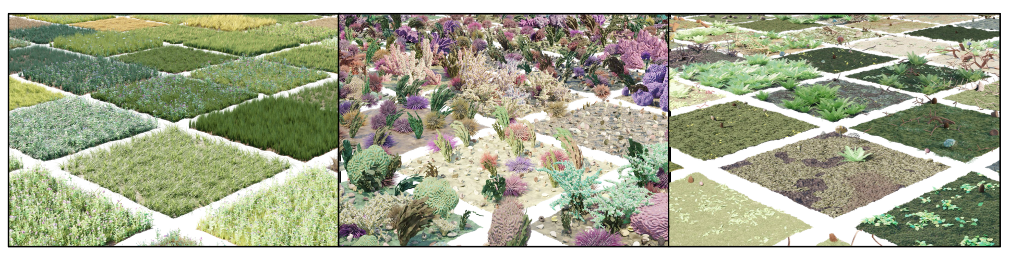
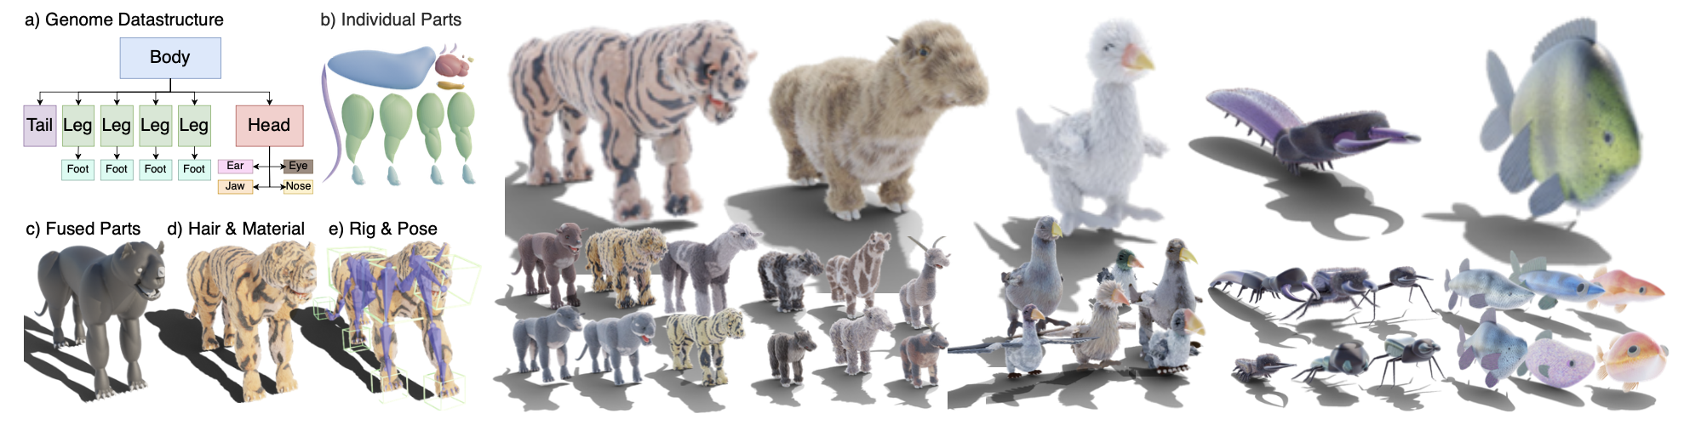
Method
Surface scatter generators
Creature generators

Slide 11
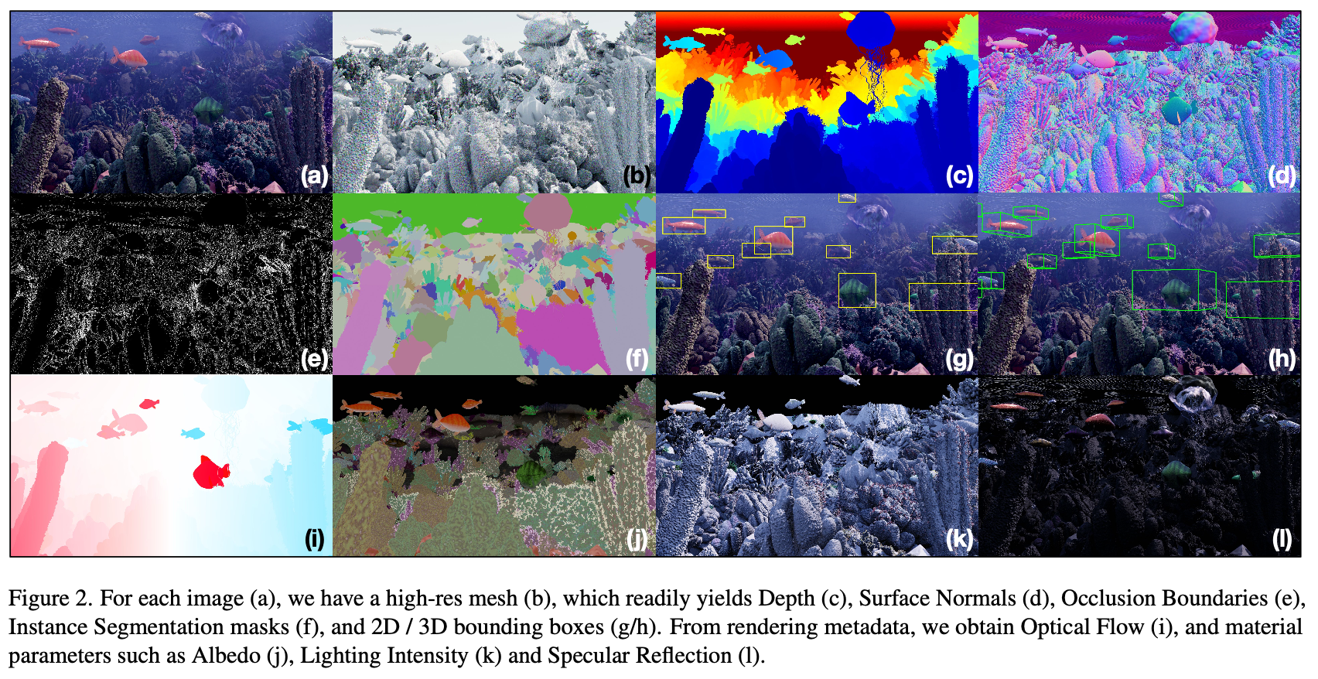
Method
Image rendering
Cycles, Blender’s physically-based path tracing renderer.

Slide 12
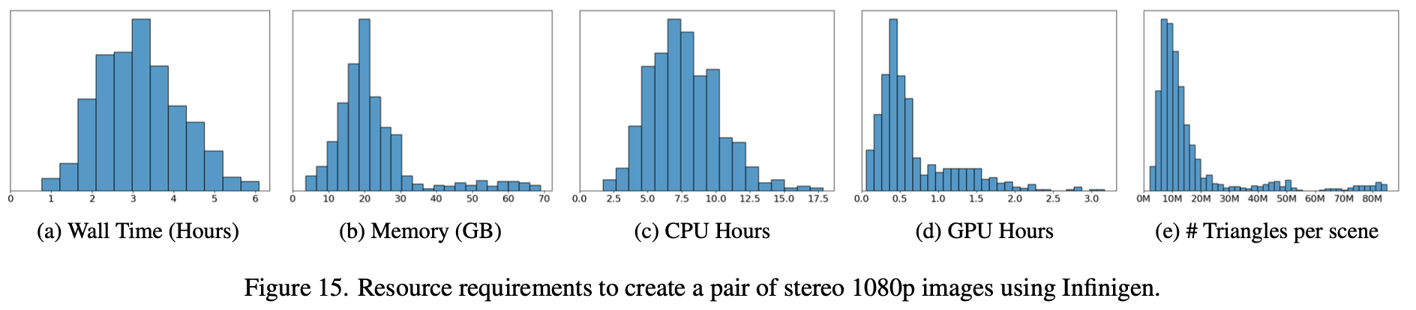
Method
Runtime

Slide 13
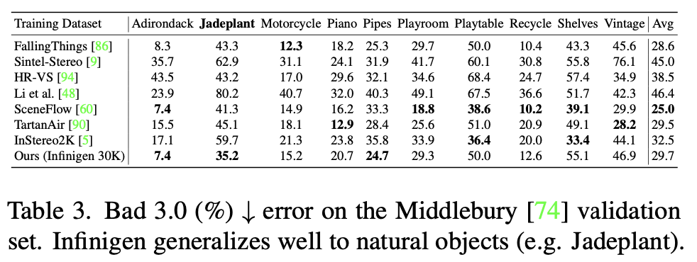
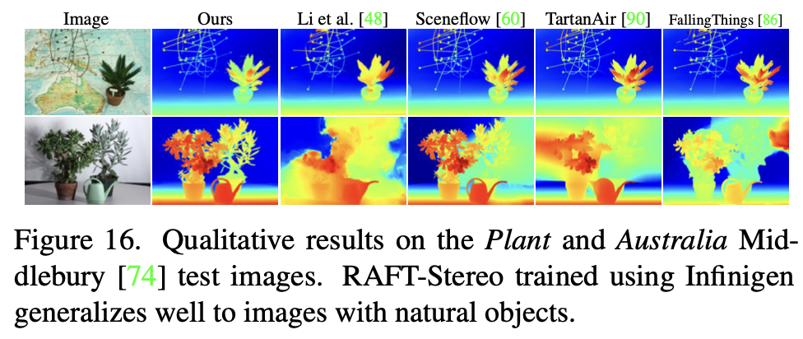
Experiments
30K image pairs with ground truth for rectified stereo matching.
Train RAFTStereo on these images from scratch and compare results on the Middlebury validation and test sets.

Slide 14
Takeaway
Infinigen for street scene; complex illuminations; involved with human activities

